Slide 1
Understanding Emergent Non-Verbal Communication in Delta Force through Multimodal AI Analysis
Jinyuan Guo, Josef Spjut
Duke University, PRICE 2026
Notes:
Talk focus:
How players use gestures to communicate intent in extraction shooters, and how AI can help detect and interpret these signals.

Slide 2
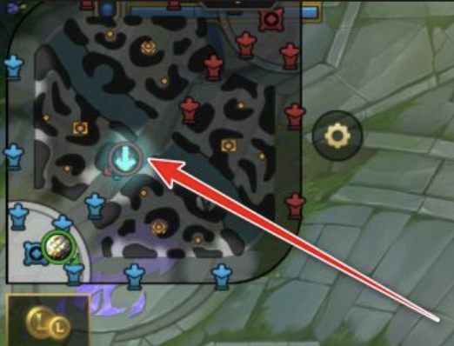
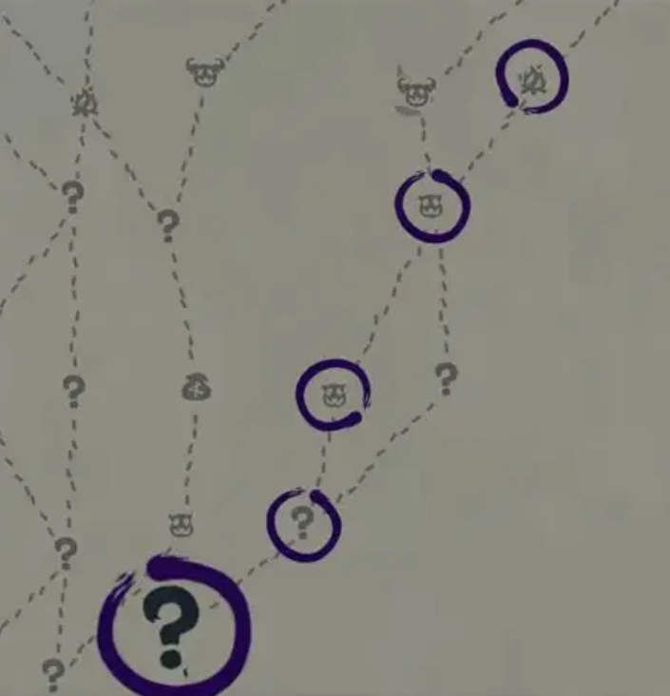
Motivation: Why Non-Verbal Communication Matters
Multiplayer games communication beyond text:
body movement
repeated actions
item dropping
emotes
UI and audio signals
Key problem:
These signals are meaningful to experienced players, but often confusing to newcomers or spectators.
Notes:
We want to identify these signals so that we can help onboard new players and understand and interpret existing culture withing a particular game community

Slide 3





Game Context: Delta Force
Extraction shooters are special:
Enter → Loot → Encounter → Fight / Signal → Extract
Death💀→ lose of equipment etc. → avoid death✔
So players may signal:
“I am friendly”
“I surrender”
“I do not want to fight”
“Take this item”
“Let’s temporarily cooperate”
Notes:
Delta force is an extraction shooter. You drop into a map at a random location collect look, maybe fight other players, and extract to bring your loot back to base.
Death is a big penalty!
Players can mutually benefit by making friends

Slide 4
Research Gap
Prior work：designed communication systems
In extraction shooters:
MOBA pings
team callouts
voice coordination
explicit game UI communication tools
signals not formally designed
meanings emerge from culture
gestures are context-dependent
signals can be cooperative or deceptive
Our focus: Emergent, non-verbal
Notes:
Prior work has looked into pings (LoL), team callouts, voice coordination, and built-in game comm tools. We’re focusing on emergent non-verbal communication, particularly when voice isn’t an option.

Slide 5
Research Goal and Contributions
Goal：
Framework for detecting and interpreting emergent non-verbal gestures from gameplay videos.
Contributions
Taxonomy
Multimodal AI pipeline
Discussion
Notes:
So given this goal, our contributions are a taxonomy for Delta Force (at least as of this writing), an example of a possible multimodal pipeline, including some AI detection, and a brief discussion of how well it works.

Slide 6
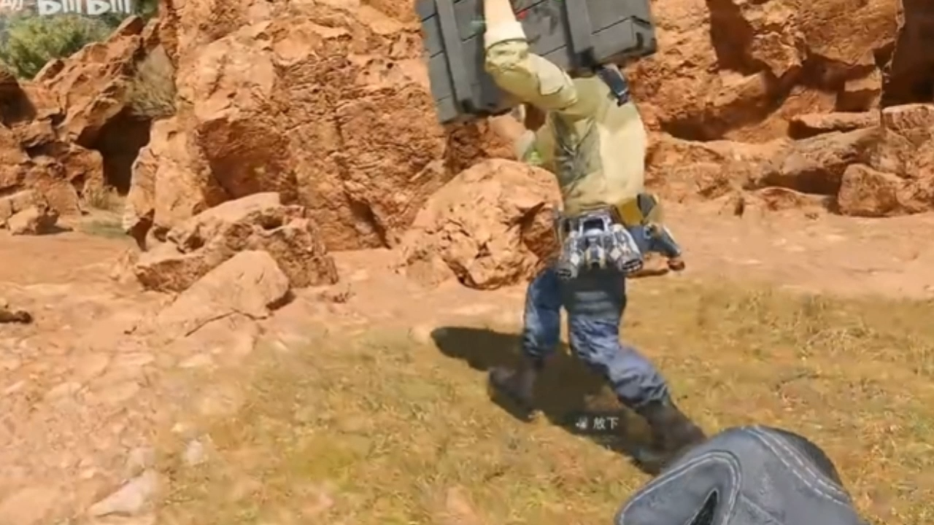
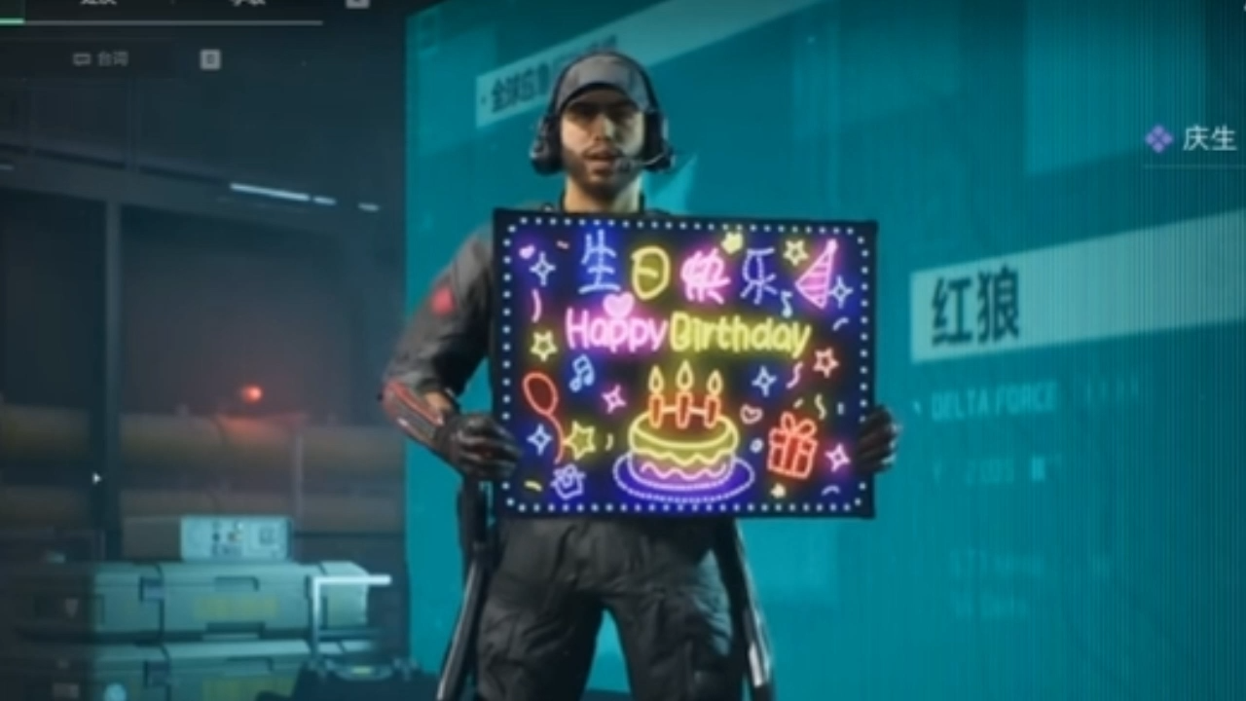
Gesture Taxonomy
From player behavior to social meaning
Atomic gestures:
carrying a box
holding a sign
kneeling
voice line “新年快乐” （xin-nian-kuai-le)
salute
placing a container
pointing at an item
Notes:
In Delta Force, there are a number of atomic gestures that can indicate friendly intentions.

Slide 7
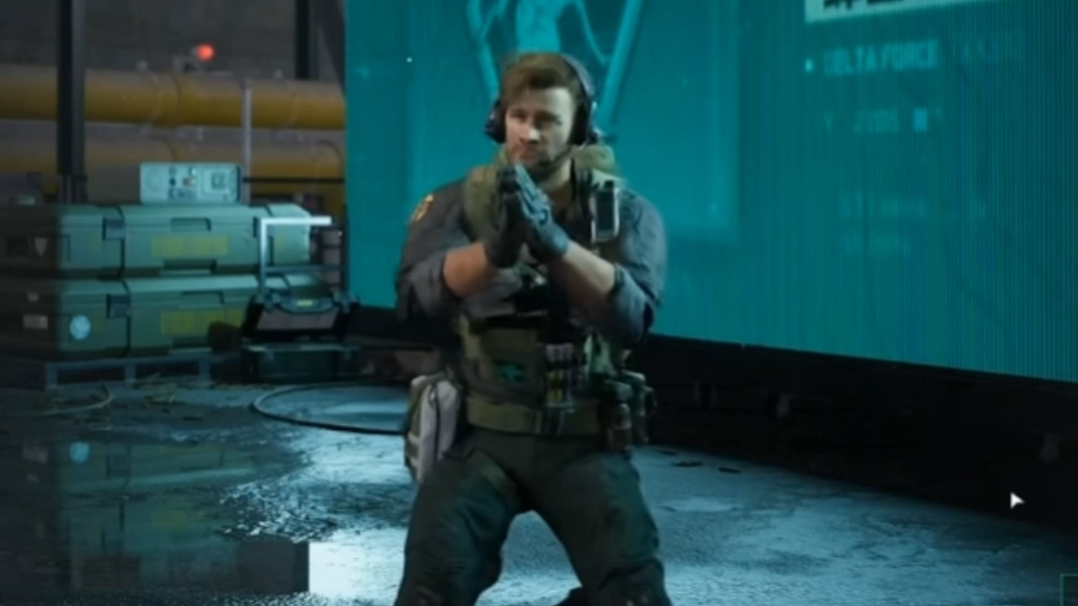
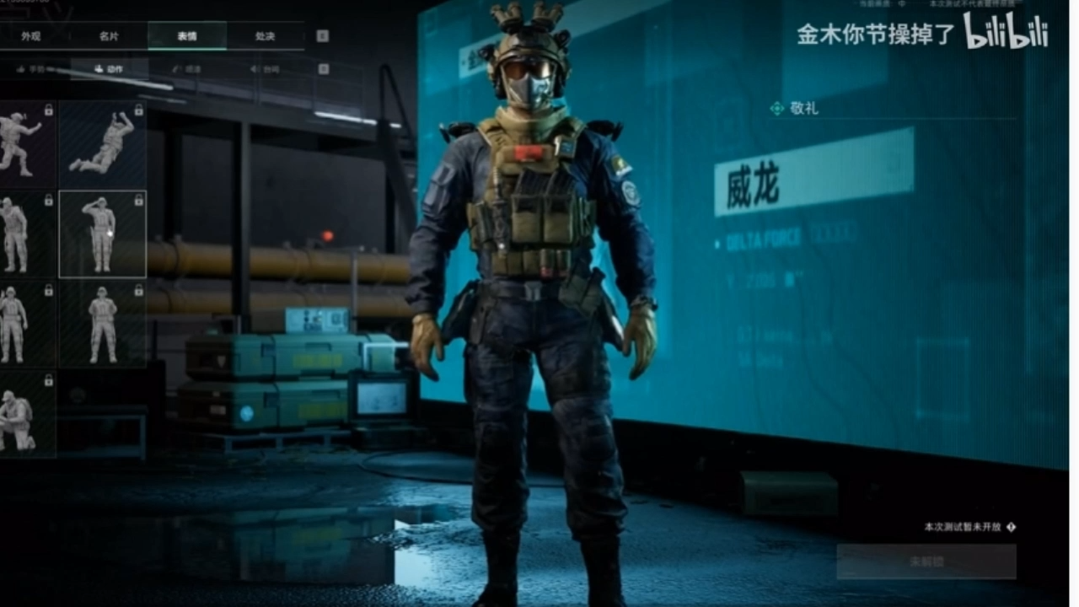
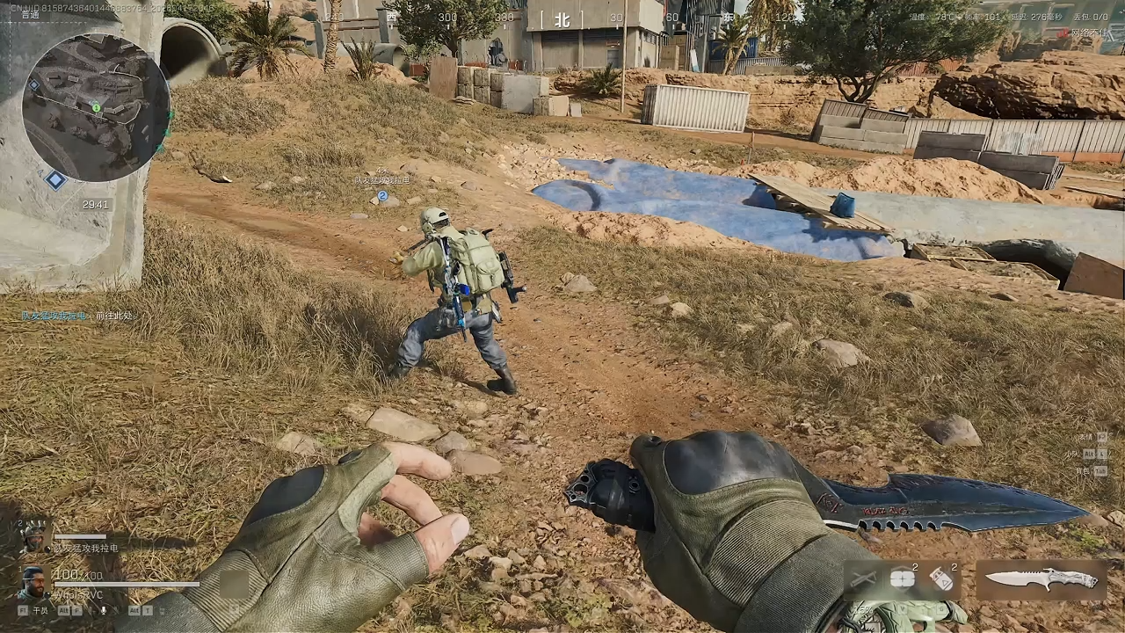
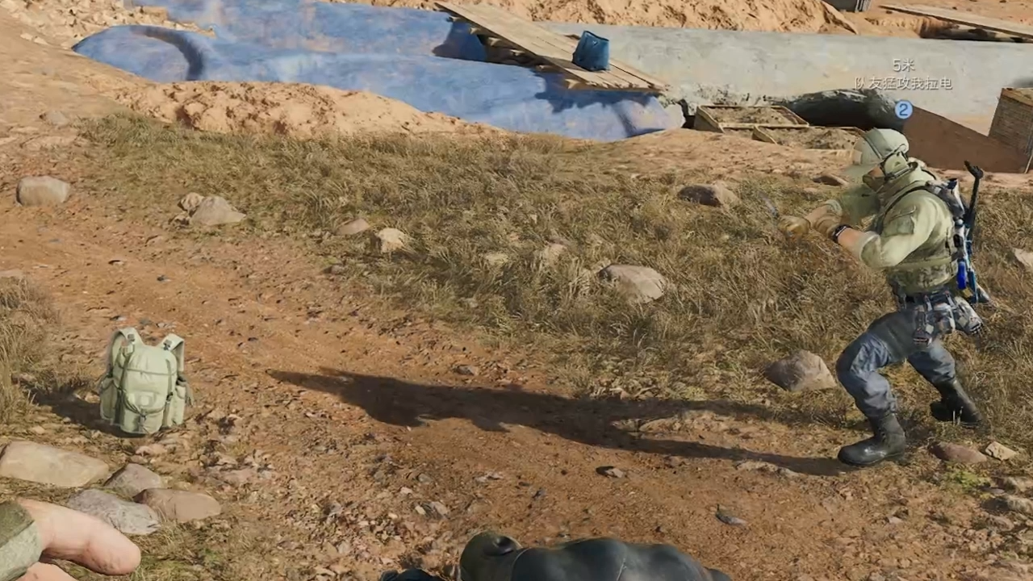
Notes:
Here are a few more examples. You can see that some of these are more or less subtle, but the community has generally grown to recognize them.

Slide 8

Composite Gestures
shaking left and right
repeated prone movement
repeated spinning
shield + jump
dropping equipment
rhythmic shooting pattern
Key idea:
Gestures become meaningful through community interpretation and repeated gameplay practice.
Notes:
There’s also composite gestures made up of multiple sequenced or repeated actions.

Slide 9
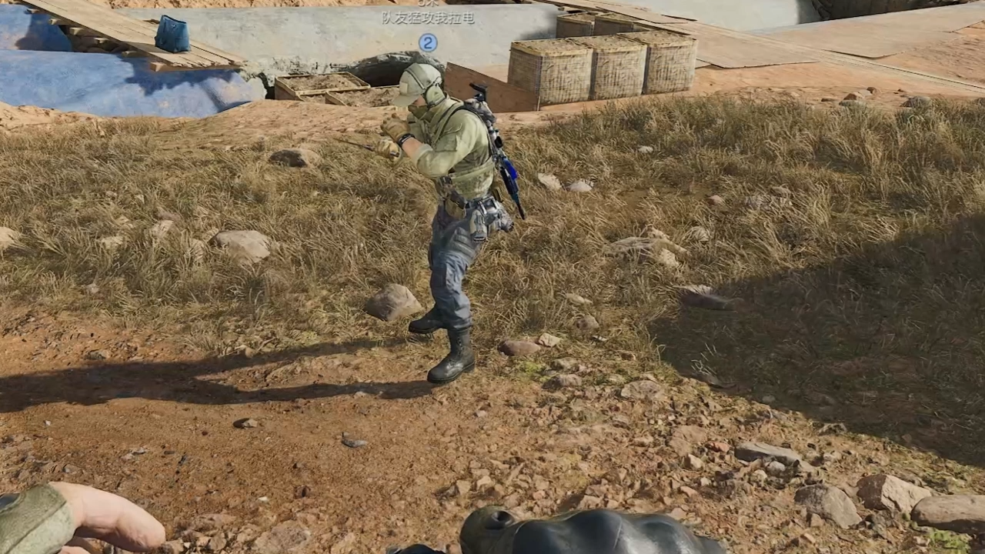
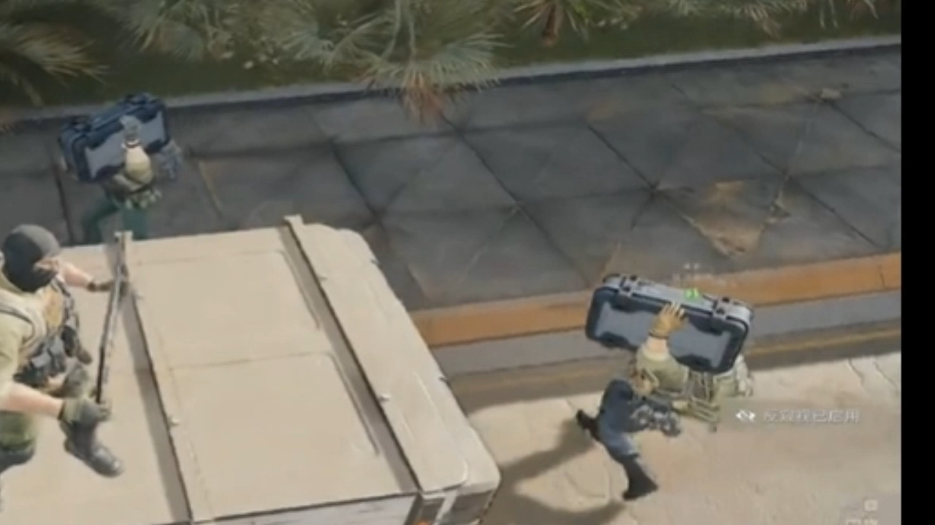
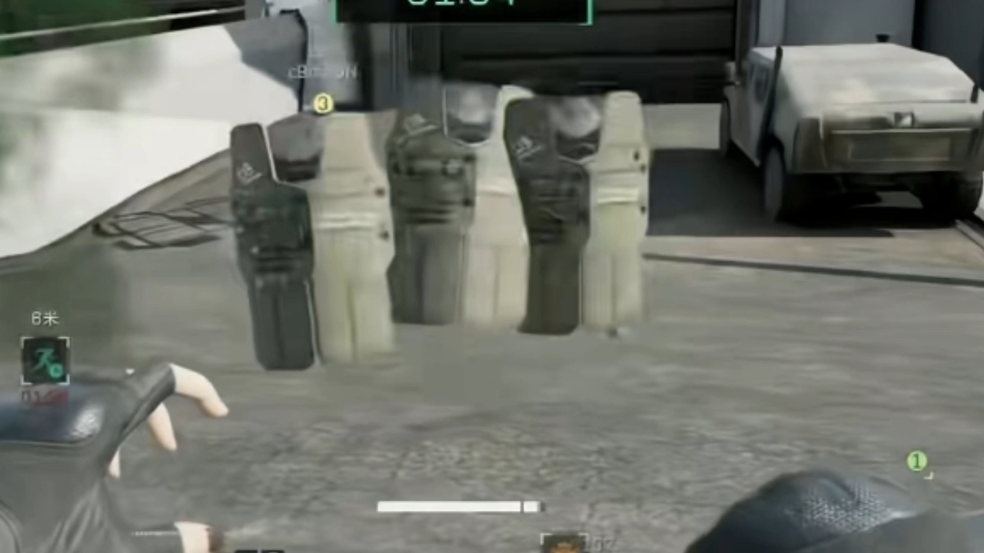
Dropping Equipment:
same posing as dropping container (previous)
Rhythmic shooting pattern:
_ _ _ _ _
Notes:
Again, these vary in the ease of detecting, and some may seem more or less obvious, like dropping equipment, which might be sort of like buying friendship.

Slide 10
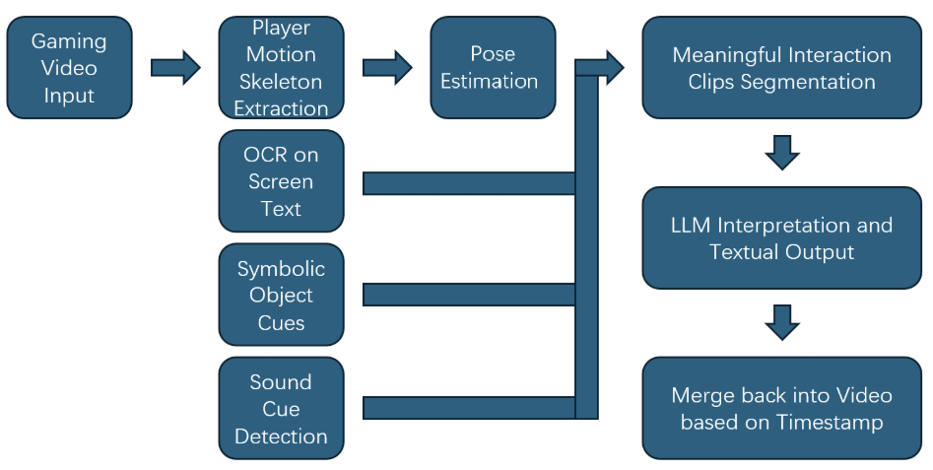
Multimodal AI Pipeline
Notes:
So given this range of gestures we wanted to detect, Jinyuan experimented with a few different options for detecting these gestures and settled on this pipeline as a compromise between what seemed to work well enough and that he could develop in his spare time during his semester at Duke. Largely he used a set of already understood building blocks like skeleton extraction and optical character recognition (OCR) that would eventually get merged into a detection and classification, followed by attaching the appropriate time stamps to line it up with appropriate video segments.

Slide 11
Preliminary Implementation
Current prototype:
Detected examples:
motion-based gesture detection
pose estimation
skeletal keypoint extraction
rule-based gesture mapping
timestamped gesture labels
confidence score
prone movement
crouch-like posture
pointing
salute-like action

Slide 12
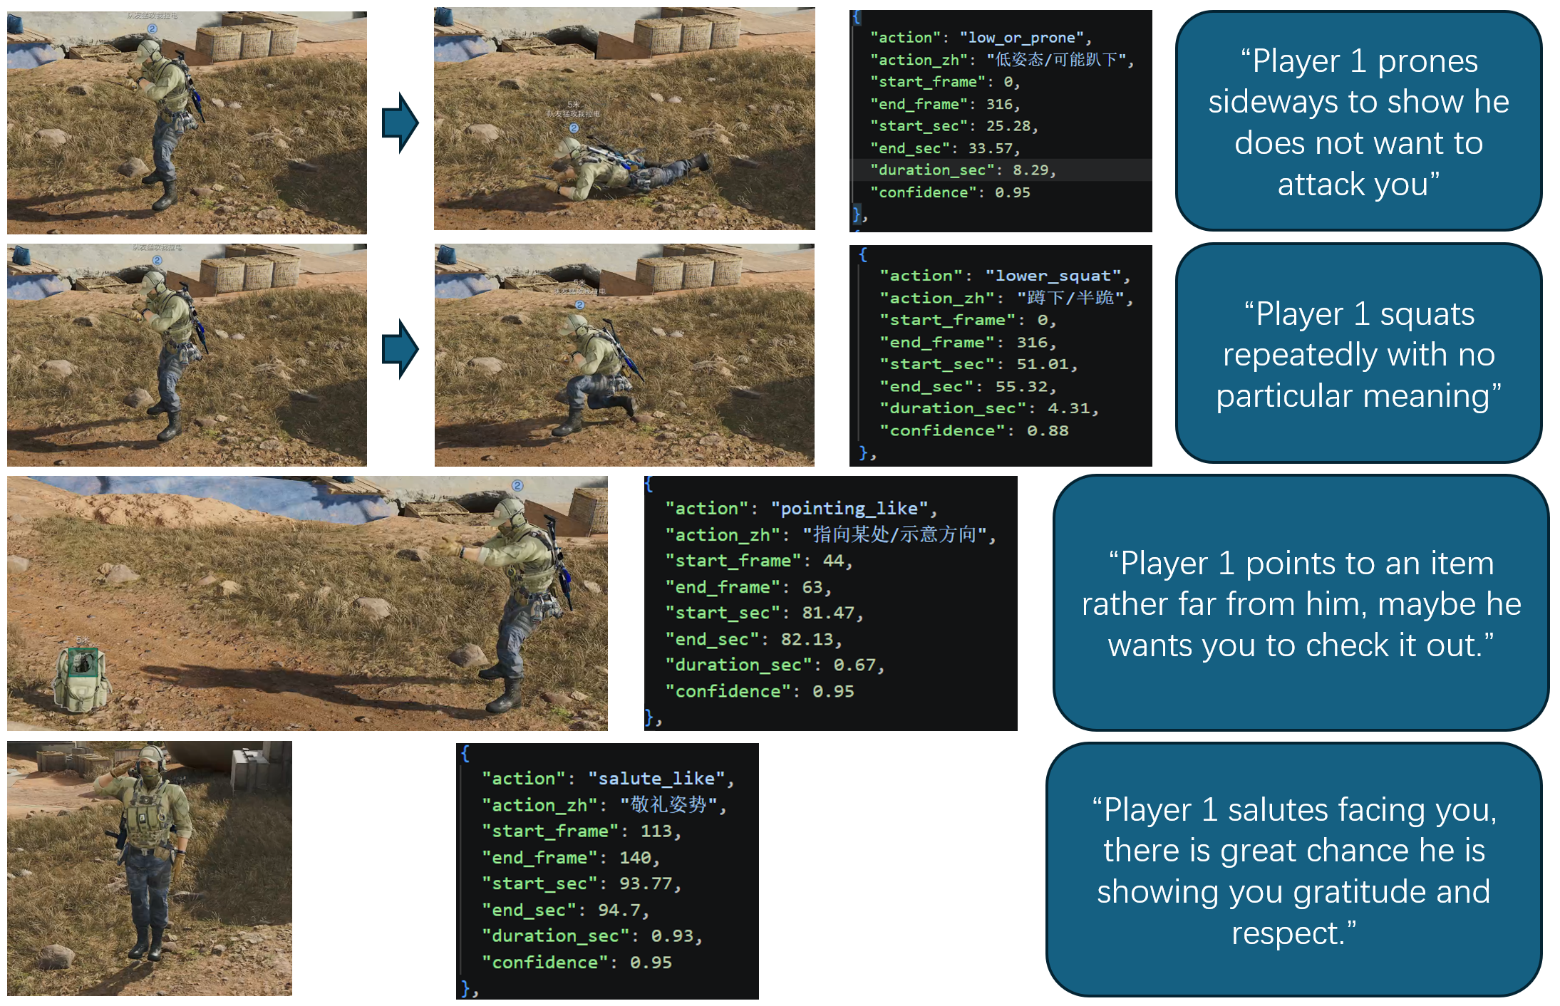
Notes:
Here are 4 example detections that work in our pipeline:
prone movement
crouch-like posture
pointing
salute-like action

Slide 13
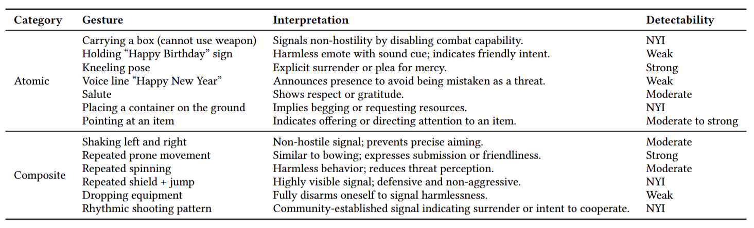
What Works and What Still Needs Work
Strong+Moderate: 6
Weak: 3
Not Implemented Yet: 4
Notes:
Given the limited development time, we weren’t able to get detection working for all of the gestures we identified, as you can see from this table. Some gestures ended up occasionally working, while others still need more work to detect.
It’s possible that something like a vision-language-model, particularly one fine tuned on Delta Force videos, would be able to detect all of this, but we haven’t attempted that yet.

Slide 14
Discussion and Takeaways
Main takeaways
Extraction shooters contain an informal “language” of player gestures.
AI can help make these signals visible and interpretable.
Gesture interpretation is ambiguous: friendliness can also be deception.
Future work should validate interpretations with experienced players.

Slide 15


Thank you for listening!
Find Jinyuan on LinkedIn!
Notes:
https://www.linkedin.com/in/jinyuan-guo-21582a2a5/

