Slide 1
PRICE Workshop
Performance, Rendering, and Interaction in Competitive Esports

Slide 2
What is Esports?
The Routledge Handbook of Esports adopts a deliberately broad definition:
“Organized and codified competition between human players using video games.”
The important components are:
  Organized: the competition has some planned structure, rather than being merely incidental play.
  Codified: it operates under established rules or competitive procedures.
  Between human players: it excludes competition solely against computer-controlled opponents.
  Using video games: the video game is the medium through which the competition occurs.
The definition appears in the chapter “Defining and Spelling Esports” by Seth E. Jenny and colleagues. The handbook also standardizes the spelling as lowercase “esports” within a sentence and capitalized “Esports” at the beginning of a sentence or in a title.
Notes:
I asked ChatGPT to give me the definition from the Routledge Handbook of Esports, and it gave me this.

Slide 3
What is Esports? Fixed
The Routledge Handbook of Esports adopts a deliberately broad definition:
“Organized and codified competition between human players using video games.”
The important components are:
  Organized: the competition has some planned structure, rather than being merely incidental play.
  Codified: it operates under established rules or competitive procedures.
  Between human players: it excludes competition solely against computer-controlled opponents.
  Using video games: the video game is the medium through which the competition occurs.
  Competition: explicit because it motivates exceptional human performance.
The definition appears in the chapter “Defining and Spelling Esports” by Seth E. Jenny and colleagues. The handbook also standardizes the spelling as lowercase “esports” within a sentence and capitalized “Esports” at the beginning of a sentence or in a title.
Notes:
Now is the part where I get up on my soap box
I think that from a computer science and human interaction perspective, the level of organization and regularity of the competitive rules are much less important than the competition itself. Competition provides motivation to players to do their best and it establishes an interactivity regime related to the visuals and graphics as well as the input and interactivity that we rarely see elsewhere. And since these are fundamentally games, the stakes aren’t life or death, so we can study highest-performance graphics and interactions without much risk.

Slide 4
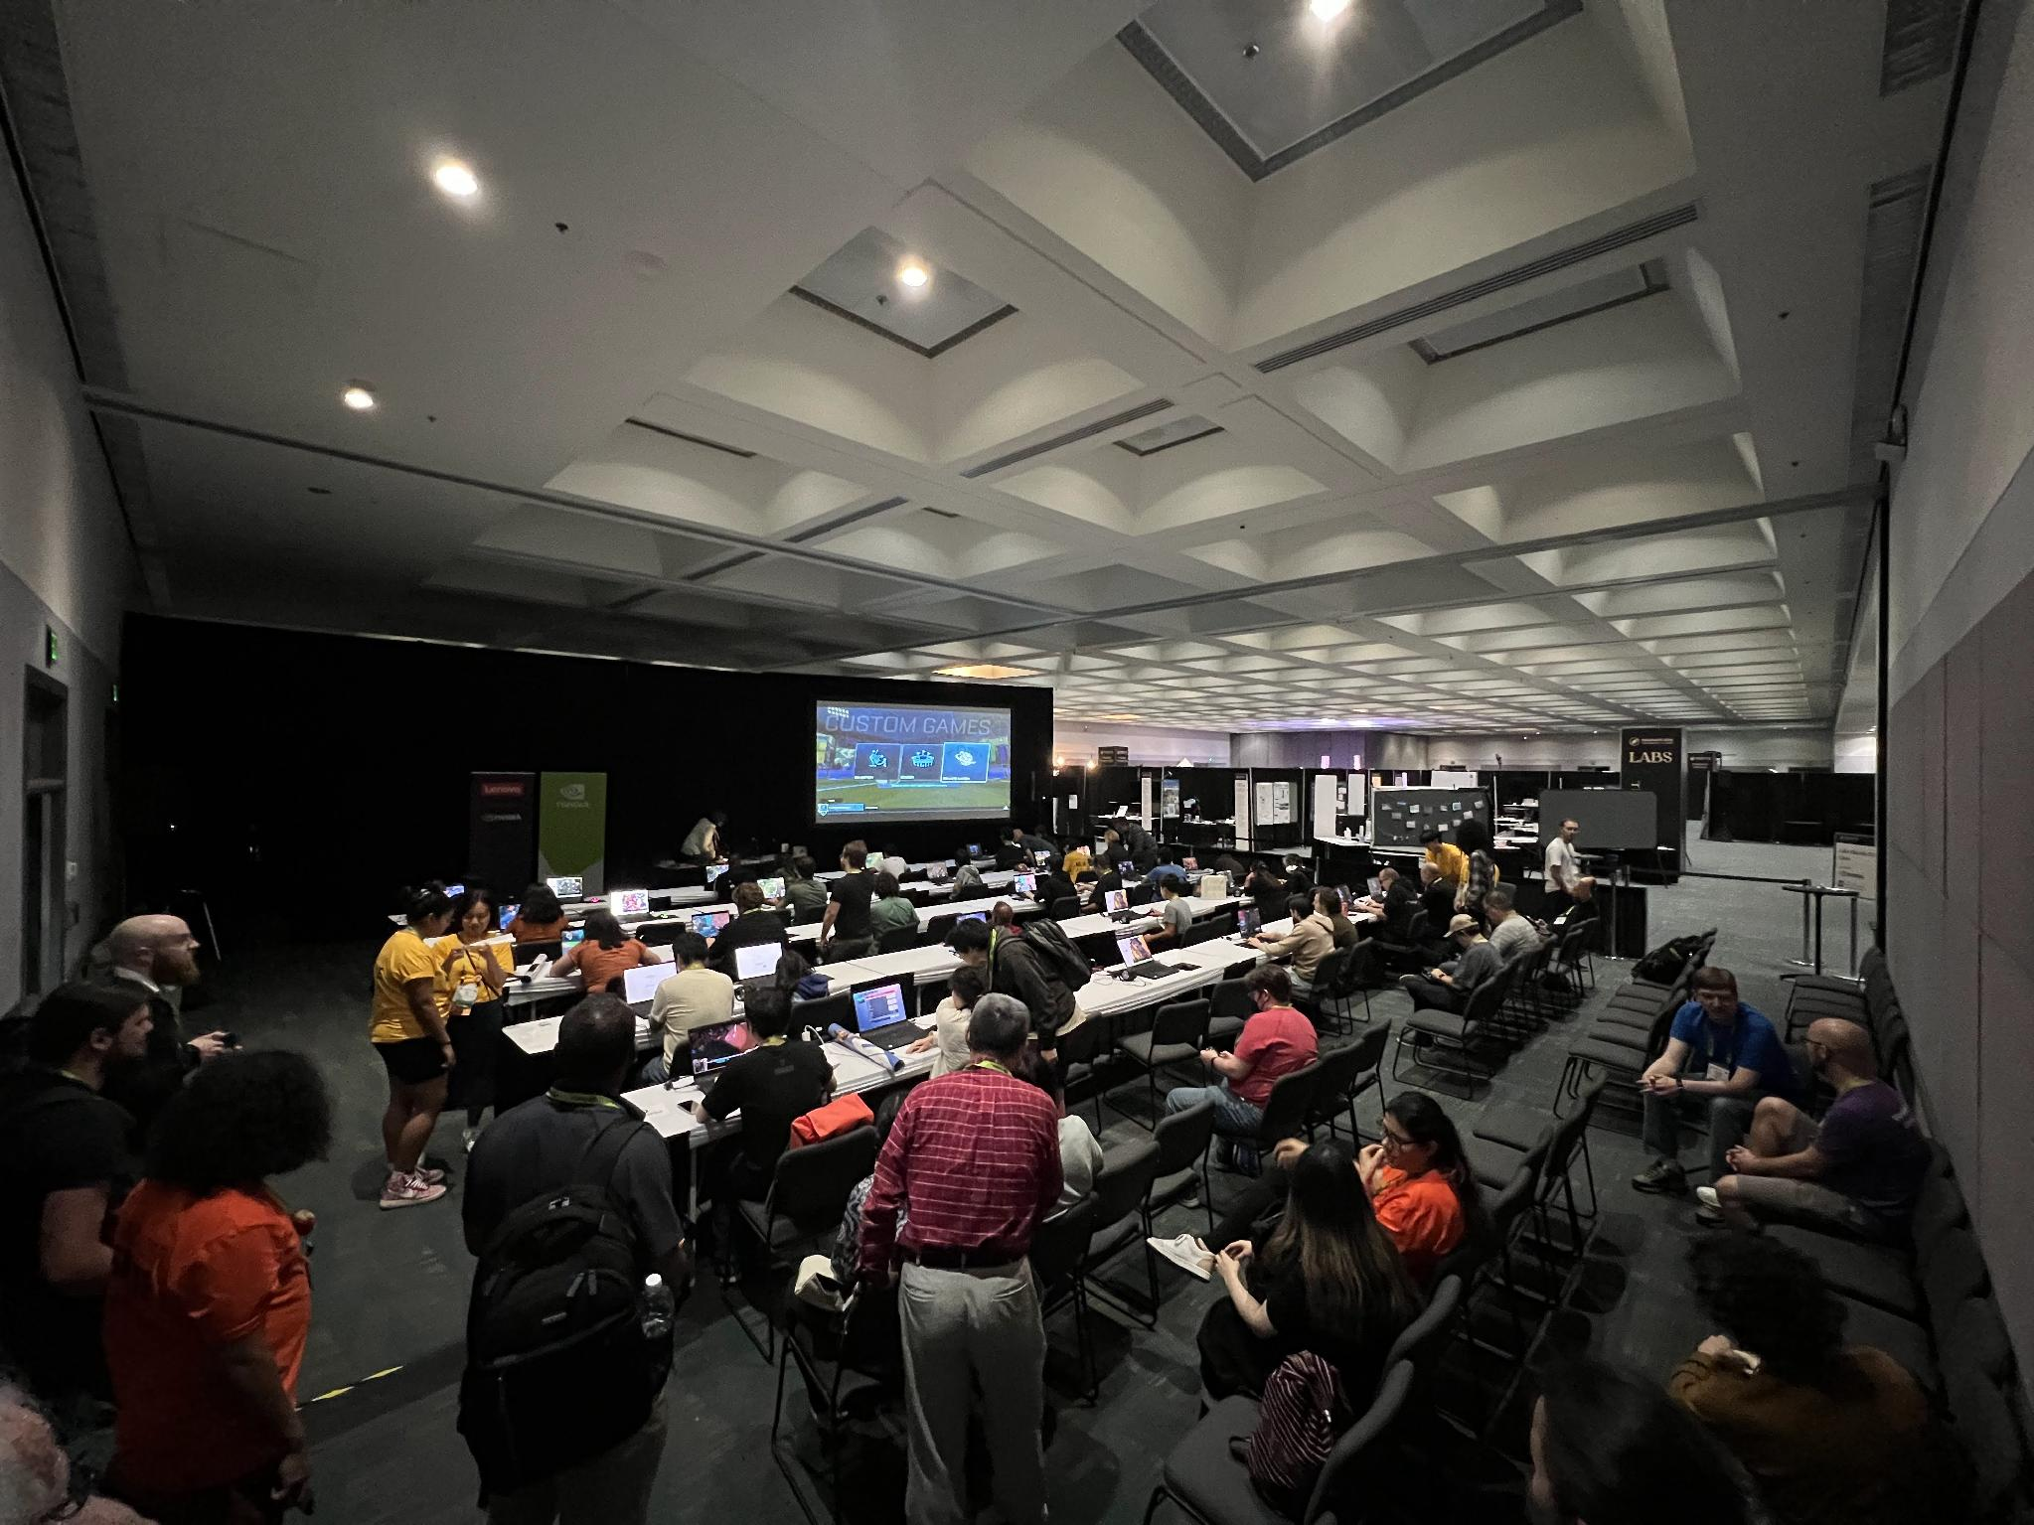

Esports at SIGGRAPH
Event History
2021 – Panel: Esports as a Driving Problem in Computer Graphics (also CHI workshop)
2022 – Frontiers Workshop: The Esports Frontier: Rendering, Interaction and Display
2023 – Frontiers Workshop: Less is More: Rendering for Esports
2023 – Rocket League tournament and Esports night!
2025 – Frontiers Workshop: Esports Rendering: Industry and Player Perspectives
2026 – Technical Workshop: Performance, Rendering, and Interaction in Competitive Esports
Notes:
We now have a multi-year legacy for events like this at SIGGRAPH, and I’d like to see this workshop continue. The QR code will send you to the archive web page with more information about these past events. I’m still doing archaeology to recover as much relevant info as I can, so if you happen to have more information about these past events that I should add, please let me know and I’ll get it linked online.

Slide 5
New this year
Keynote
Sketch submissions!

Slide 6
Josef Spjut
Organizers
Benjamin Watson
Dr. Madison Klarkowski
NVIDIA
North Carolina State University
Queensland University of Technology
Rulon Raymond
Mark Claypool
Paul Ritaldato
Infinity Ward
Worcester Polytechnic Institute
Epic Games

Slide 7
Agenda
2:05 — Keynote: Mark Claypool
3:15 — Sketch Session 1:
  Towards Field Experiments in Esports Competition
  What Do Competitive Players Do With Their Settings? A Multi-Game Esports Configuration Survey
  [Invited] Tactical Telemetry: Using Replay Files for Gameplay Analytics
3:51 — Panel 1: Moderator: Rulon Raymond; Panelists: Arjun Madhusudan, Ashish Rajpurohit, Peter Xenopoulos
4:20 — Sketch Session 2:
  AI Level of Detail: Distance-Aware ML Model Precision Selection for Real-Time Human Motion Prediction in Games
  Improving Interaction by Transforming the Render-Display Pipeline
  Understanding Emergent Non-Verbal Communication in the Delta Force Competitive Video Game through Multimodal AI Analysis
4:56 — Panel 2: Moderator: Ben Watson; Panelists: Matthew Varghese, Aaron Fulmer, Evan Jonson, Josef Spjut

Slide 8

Get Involved!
Mailing list
Discord
Website: https://price-workshop.org
Interested in organizing next year? Let us know!

Slide 9
Keynote
Mark Claypool

Slide 10
Break until 3:15: Up next Sketch Session 1 and Panel
Discord and Mailing List
2:05 — Keynote: Mark Claypool
3:15 — Sketch Session 1:
  Towards Field Experiments in Esports Competition
  What Do Competitive Players Do With Their Settings? A Multi-Game Esports Configuration Survey
  [Invited] Tactical Telemetry: Using Replay Files for Gameplay Analytics
3:51 — Panel 1: Moderator: Rulon Raymond; Panelists: Arjun Madhusudan, Ashish Rajpurohit, Peter Xenopoulos
4:20 — Sketch Session 2:
  AI Level of Detail: Distance-Aware ML Model Precision Selection for Real-Time Human Motion Prediction in Games
  Improving Interaction by Transforming the Render-Display Pipeline
  Understanding Emergent Non-Verbal Communication in the Delta Force Competitive Video Game through Multimodal AI Analysis
4:56 — Panel 2: Moderator: Ben Watson; Panelists: Matthew Varghese, Aaron Fulmer, Evan Jonson, Josef Spjut

Slide 11
Break until 4:27: Up next Sketch Session 2 and Panel
Discord and Mailing List
2:05 — Keynote: Mark Claypool
3:15 — Sketch Session 1:
    Towards Field Experiments in Esports Competition
    What Do Competitive Players Do With Their Settings? A Multi-Game Esports Configuration Survey
    [Invited] Tactical Telemetry: Using Replay Files for Gameplay Analytics
3:51 — Panel 1: Moderator: Rulon Raymond; Panelists: Arjun Madhusudan, Ashish Rajpurohit, Peter Xenopoulos
4:20 — Sketch Session 2:
  AI Level of Detail: Distance-Aware ML Model Precision Selection for Real-Time Human Motion Prediction in Games
  Improving Interaction by Transforming the Render-Display Pipeline
  Understanding Emergent Non-Verbal Communication in the Delta Force Competitive Video Game through Multimodal AI Analysis
4:56 — Panel 2: Moderator: Ben Watson; Panelists: Matthew Varghese, Aaron Fulmer, Evan Jonson, Josef Spjut

